Slide 1
Data Visualization with Python
IBM Course Eight Week One

Slide 2
Objectives
Make visualizations effective, attractive, and impactive
Explain Darkhorse Analytics and apply the approach to your own visualizations
Use Matplotlibs to create plots
Identify the three layers of Matplotlibs, and understand the functions of each layer

Slide 3
Intro to Data Visualization
A picture is worth 1000 words!
Creating and transforming visuals that are effective, attractive, and impactful
Graphical form → easy to understand
Good for when you need to get acquainted with the data
Don’t distract from the data – find a balance

Slide 4
Why Build Visuals?
Convey a clear description of the data to disclose findings to audience
Notes:
Exploratory data analysis
Communicate clear data
Share unbiased representation
Support recommendations to stakeholders

Slide 5
Darkhorse Analytics
“Less is more…”
Notes:
→ less is more effective, is more attractive, and more impactive

Slide 6
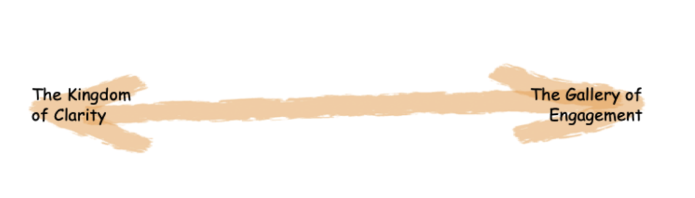
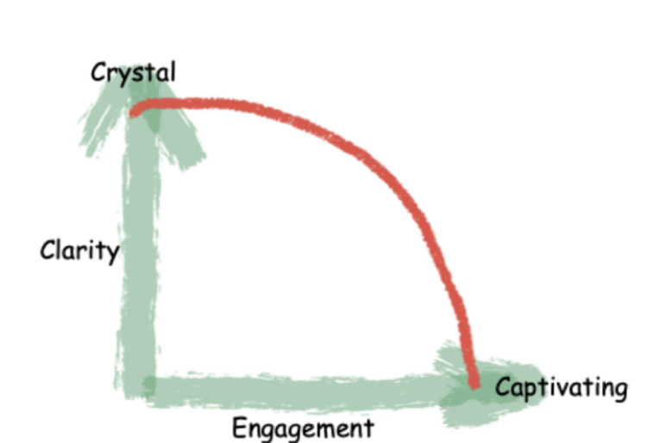
Darkhorse Analytics Approach
Crystal
Clarity
Engagement
Captivating
Notes:
Clarity → Things that are more decision-oriented will learn toward clarity; separate the noise from the message
Engagement → delight your audience
In what situations would engagement trump clarity? Ex. Want to get 1,000,000 followers = engagement is key; air traffic control center = clarity is key
**came out of University of Alberta in 2008*

Slide 7
Ask the Right Questions
Who is your target audience?
What is the main message you’re trying to convey?
What do you want your audience to do about it?
*Be as specific as possible when exploring these questions.*

Slide 8
Matplotlib
Created by John Hunter , neurobiologist
Most popular data visualization library in Python
Three main layers: backend, artist, scripting layer

Slide 9
Matplotlib’s Layers
Backend
Artist
Scripting
3 built-in abstract interface classes: FigureCanvas, Renderer, Event
One main object: the artist
Two types of artist objects: primitive and composite
Meant for individuals who are not professional programmers
Automates processes
Notes:
Backend:
FigureCanvas → defines and encompasses the area on which the figure is drawn
Renderer → knows how to draw on the figure canvas
Event → user input (like key strokes, etc.)
Artist:
Artist knows how to use the Renderer and draw on the canvas
Primitive → line, rectangle, circle, text
Composite → figure or axes
Each composite artist may contain other composite artists as well as primitive ones
Syntactically heavy
Scripting:
Matplotlib.pyplot interface
Automates the processes of defining a canvas and defining a figure artist

Slide 10
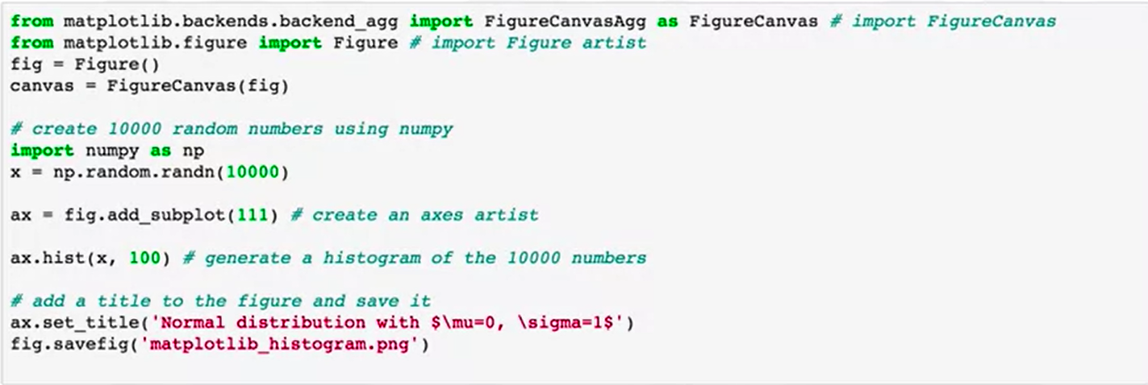
Break it Down
Notes:
In your Scrum groups, discuss each:
What does agg stand for?
Does the axes artist need to be manually added or is it automatically added to the figure axes container?
What does 111 refer to/create?
What is the title of the Histogram created here?

Slide 11
Basic Plotting
Jupyter Notebook
Pandas → built in
Plot function
Magic Function
Notebook Backend
*What is a limitation of the Magic function that the Notebook backend can be used to overcome?*
Notes:
Pandas → has a built-in implementation of Matplotlib
Jupyter Notebook → open-source, web app that allows one to create and share documents that contain live code visualizations and explanatory text
Plot function → can be used to create all visualization tools such as histograms, charts, box plots etc.
Magic function → % Matplotlib; limitation is that you cannot modify a figure once it is rendered
Notebook backend → if a plt function is called, it checks to see if active figures exist and applies them. If no active ones exist, it renders a new one.

Slide 12
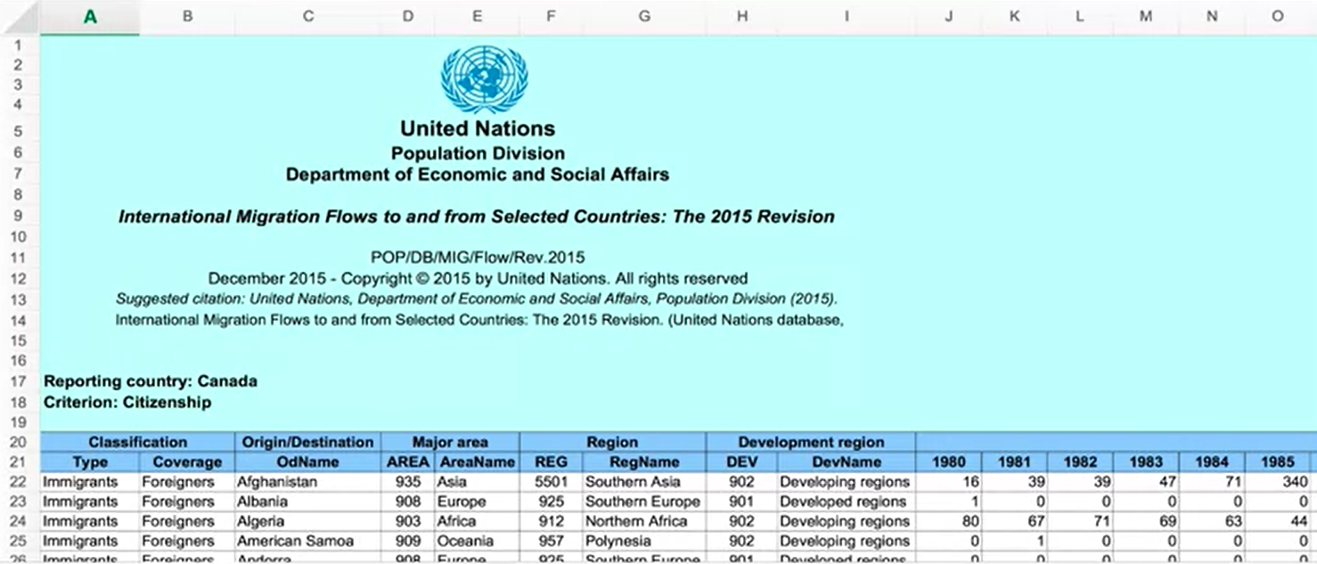
Info on the Dataset → Immigration to Canada
Data pertaining to 45 countries
Will create plots for the data for exploratory analysis and presentation
Use Pandas and xlrd → import libraries
Import data and check you’ve imported the right rows/columns

Slide 13
What is a Line Plot?
Notes:
Type of plot that displays info as a series of data points. These points are called “markers” and are connected by straight lines.

Slide 14
Take the next 1.5 hours to do the lab, quiz, and final reading.

